Slide 1
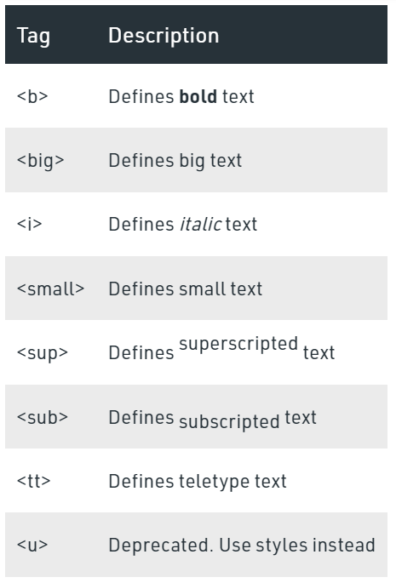
Physical Tags
Physical Tags are used in HTML to provide actual physical formatting to the text.

Slide 2
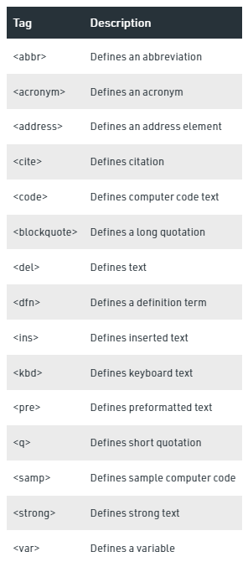
Logical Tags
Logical Tags are used in HTML to display the
text according to the logical styles.

